Slide 1


L.P. Miles Elementary,
DATE 10/19/2023
TIME 5:00 p.m. Location: L.P. Miles
Principal Thalise Perry

Slide 2

AGENDA
Staff Introductions
  Thalise Perry, Principal
  Dr. Darnisha Johnson (Assistant Principal)
  Keisha Miles (Assistant Principal)
  Sonja Peguese (Engagement Specialist)
What You Need to Know About Title I
  What Is Title I?
  What is the Schoolwide Improvement Plan?
  What are our goals?
  What curriculum does our school use?
  What tests will my scholar take?
Parent and Family Engagement
  Communicating and Partnering with Families
  What is the School-Parent Compact?
  What is the School Parent and Family Engagement Plan?
  What is the District Parent and Family Engagement Statement?
  What opportunities and events will the school offer parents?
Closing

Slide 3

OUR PHILOSOPHY
Mission
Vision
Motto
Miles Elementary will
provide a safe and
nurturing environment
that promotes academic
success, models life-long
learning and prepares
learners to become active
globally compassionate and
open-minded citizens.
Miles Elementary is to be
nurturing, comprehensive,
and high performing school
where faculty, staff,
parents, and all
stakeholders will
concertedly prepare our
students to become
globally competitive
citizens.
At Miles Elementary we
Inspire, we Motivate, we
Care, we Teach!

Slide 4

What is Title I ?
It’s the largest federal aid program for public schools in the United States.
Title I is designed to support State and local school reform efforts tied to the challenging State academic standards to improving teaching and learning for students.
Title I programs must be based on effective means of improving student achievement and include strategies to support parent and family engagement.
Notes:
This is where you will share a definition of Title I.

Slide 5

How Does Our School Spend Title 1 Money
Personnel
Parent Resource Center
Instructional Materials
Professional Learning
Technology (Subscriptions, Intervention software, and more)

Slide 6
2023-2024 SMART Goals
Literacy
Math
Whole Child
By Spring 2024, increase the number of students scoring proficient or above in ELA from 14.2% to 21% as measured by the Georgia Milestone Assessment.
By Spring 2024, increase the number of students scoring proficient or above in Math from 12.5% to 19% as measured by the Georgia Milestone Assessment.
Miles will decrease the number of incidents and out of school suspensions by 50% (Behavior incidents 17 or fewer; Out of school suspensions .7 or lower).

Slide 7
Miles Elementary Instructional Resources
Fundations/ ReadyGen-Literacy
Fundations K-3rd
Fundations is a systematic phonics, spelling, and handwriting program designed for students in grades K–3. It is aimed at reducing reading and spelling failure. The program involves daily 30-minute lessons that focus on carefully-sequenced skills that include print knowledge, alphabet awareness, phonological awareness, phonemic awareness, decoding, spelling, and vocabulary development.
ReadyGen K-5
ReadyGEN is an English language arts curriculum for grades K-6 that focuses on reading and writing.
StemScopes-Science
STEMscopes Georgia creates a student-centric blended STEM learning environment where teachers are able to teach, intervene, and accelerate their diverse students. Built on a digital platform, enhanced by print, and brought to life in hands-on kits, STEMscopes digital resources and on-demand print come to life through hands-on kits offering teachers an adaptive platform that increases engagement, rigor, and student achievement.
The Georgia standards of excellence guide everything that we do.
GADOE/ Envisions-Math
Georgia Standards of Excellence
The standards are organized into big ideas, grade level competencies/standards, and learning objectives. The grade level key competencies represent the standard expectation of learning for students in each grade level. The competencies/standards are each followed by more detailed learning
objectives that further explain the expectations for learning in the specific grade levels.
Envisions
enVisionmath2.0 is a comprehensive K-8 mathematics curriculum with superior focus, coherence, and rigor. Ensure success at every level with problem-based learning, embedded visual learning, and personalization to empower every teacher and student.
Studies Weekly-Social Studies
Social Studies curriculum organized thematically to the strands of civics and government, geography, economics, and history state standards.

Slide 8
District Assessments
Assessment | What Does it Measure | Grade Levels | Dates
MAP Growth Reading & Math | MAP® Growth™ is the standard-bearer for measuring achievement and growth in K–12 math, reading, language usage, and science | K-5 | August, November, April
MAP Reading Fluency | MAP® Reading Fluency™ enables teachers to efficiently measure oral reading fluency with an online, adaptive benchmark and progress monitoring assessment. | K-3 | August, November, April
Write Score | Write Score is a program that provides tools to schools and teachers to help students improve their literacy. The program is also helpful for teachers to pinpoint the weak areas in their writing program. | 1st-5th (K-January & March Only) | November, January, March
GKIDS | GKIDS will also provide a summary of student performance in English Language Arts and Mathematics at the end of the kindergarten school year. GKIDS should serve as one indicator of first grade readiness. GKIDS will serve both a formative and summative role in assessing kindergarten students. | Kindergarten | August-May
Georgia Milestones (ELA, Math, Science (5th Only) | ​​​​​​​​​​​​​​​​​​​​​​​​​​​​​​​​​​​​​​​​​​​​​​​​​​​​​​​​​​​​​​​​​​​​​​​​​​​​​​​​​​​​​​​​​​​​​​​​​​​​​​​​​​​​​​​​​​​​​​​​​​​​​​​​​​​​​​The Georgia Milestones Assessment System is a comprehensive summative assessment that is designed to provide information about how well students are mastering the state-adopted content standards in the core content areas of English language arts, mathematics, science, and social studies. | 3rd-5th | May

Slide 9

WHAT IS PARENT AND FAMILY ENGAGEMENT?
Parent and Family Engagement is an ongoing process that increases active participation, communication, and collaboration between parents, schools, and communities with the goal of educating the whole child to ensure student achievement and success.

Slide 10
School Parent and Family Engagement Plan
The plan establishes the school’s expectations for parent and family engagement and describes how our school will implement a number of specific parent and family engagement activities, and it is incorporated into the school’s plan submitted to the local educational agency (LEA).
School Parent Compact
School parent compact outlines how the parents, the entire school staff, and the students will share the responsibility for improved student academic achievement as well as describes how the school and parents will build and develop a partnership that will help children achieve the state’s high standards.
District Parent And Family Engagement Statement
The statement establishes Atlanta public school’s expectations and objectives for meaningful parent and family engagement and describes how the district will implement a number of specific parent and family engagement activities, and it is incorporated into the lea’s plan submitted to the Georgia Department of Education.
SCHOOL COMPACTS AND PLANS WILL BE DISTRIBUTED ONLINE (school website and class dojo)AND HARD COPIES WILL BE SENT HOME NEXT WEEK

Slide 11
UPCOMING PARENT AND FAMILY ENGAGEMENT EVENTS!
Fall Festival 11/3
IB night/Parent Conferences 11/9
Family Luncheon 11/16
Parents and families we look forward to you joining us for these opportunities and events. If you are interested in getting involved, please reach out to your child’s teacher or Mrs. Peguese the engagement specialist

Slide 12

Parent Resource Center
The parent resource center has community resources available, volunteer information, and monthly newsletters. There are computers available where parents can access the Infinite Campus Portal to view scholar’s grades online and for parents to career search. Please feel free to stop by.
Mrs. Peguese, Engagement Specialists
(404) 802-8900
sonja.peguese@atlanta.k12.ga.us

Slide 13
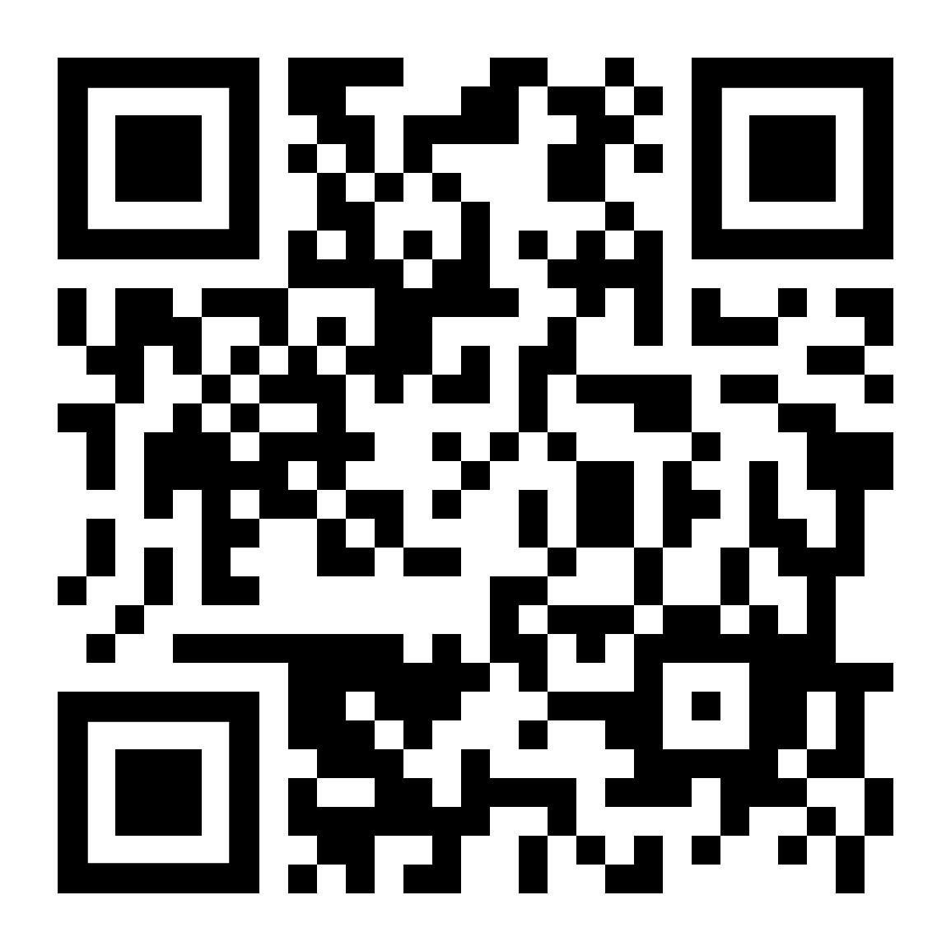
QUESTIONS?
Give us your feedback!
Do you have any questions?
How can we help?
What does your student need?
THANK YOU FOR ATTENDING!
PLEASE SCAN THE QR CODE TO COMPLETE OUR SURVEY.

